Slide 1
Kuali Student CDM Presentation
e-Strategy Open House, January 28 2010

Slide 2
Agenda
What is the UBC Community saying about Curriculum Development and Approval?
What is Kuali Student – Module One (CDM) offering to address ?
KS CDM – a sneak peek

Slide 3
What is the UBC Community saying?
Learning Environment
SIS doesn’t support non-credit courses / experiential learning
Forced to use workarounds (special topics, directed studies)
Students and faculty frustrated by courses listed but not offered
Organizations, People
Limited understanding of collaborators, approvers and workflow
Paper based process is time consuming, difficult and error-prone
Time
No support for flexible timeframes for courses
No ability to track proposal progress over time
Time required for approval is unacceptable

Slide 4
What does KS-CDM Offer?
Learning Environment
Supports non-credit courses and new types of learning experiences (project based, experiential) reducing need for workarounds
Leads to fewer courses listed but not offered – reduce frustrations
Organizations, People
Supports automated collaboration and approvals based on organization roles
Support the management & tracking of proposals from inception to approval
Intuitive user interface without double entry
Time
Allows flexible timeframes for courses
Opportunity to drastically reduce time required to approve courses

Slide 5
KS-CDM Peek
Current slides are based on an early release
Kuali Reference University (KRU) is used
You will notice that colours and text do not reflect UBC environment
Our focus as the implementation team....
tailor product to specific UBC functionality and branding

Slide 6
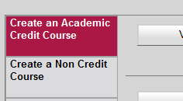
Main Kuali Student CDM Screen
Navigation Support
Proposer
Department
Faculty
Senate
Course Catalogue

Slide 7
Starting a New Proposal
Organized structure to assist with proposal documentation flow
Proposer
Department
Faculty
Senate
Course Catalogue

Slide 8
Entering Proposal Information
On-line fields with pick lists
Proposer
Department
Faculty
Senate
Course Catalogue

Slide 9
Cross Listing Support
Recognize Cross listing and joint offerings
Proposer
Department
Faculty
Senate
Course Catalogue

Slide 10
Specific Proposal Information
Supports varied terms and timeframes
Identify multiple learning experiences within a course
Proposer
Department
Faculty
Senate
Course Catalogue

Slide 11
Document Learning Criteria
Share and develop learning objectives criteria
Proposer
Department
Faculty
Senate
Course Cat

Slide 12
External Documents
Attach external documents for further clarification of proposal
Proposer
Department
Faculty
Senate
Course Catalogue

Slide 13
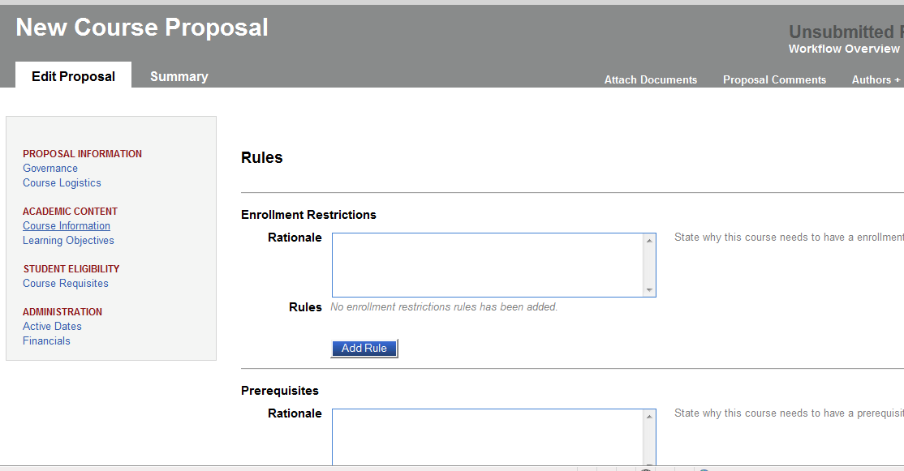
Course Restrictions and Rules
Add restrictions and requisite rules easily with data integrity
Proposer
Department
Faculty
Senate
Course Catalogue

Slide 14
Course Rules
Support for complex restriction and requisite rules
Natural Language assists in understanding complex rules
Proposer
Department
Faculty
Senate
Course Catalogue

Slide 15
Collaboration
Add additional consultations easily
Proposer
Department
Faculty
Senate
Course Catalogue

Slide 16
Automated Workflow
Automatic routing based on organization workflow
Proposer
Department
Faculty
Senate
Course Catalogue

Slide 17
Automated Workflow
Track proposal automatically
Automated consultations based on organization
Proposer
Department
Faculty
Senate
Course Catalogue
Notes:
Note Earl in workflow request to approve . We use him in the later workflow slides and log in as him to approve

Slide 18
Workflow Routing
Once Fred chooses to submit his proposal workflow begins
Automatic routing to reviewers, approvers
Collaborators and approvers log in to system and see their actions and decisions
Our next step... Log in as Earl

Slide 19
Workflow - Earl
Action list for collaborators and approvers
Dynamic access to proposal
Proposer
Department
Faculty
Senate
Course Catalogue

Slide 20
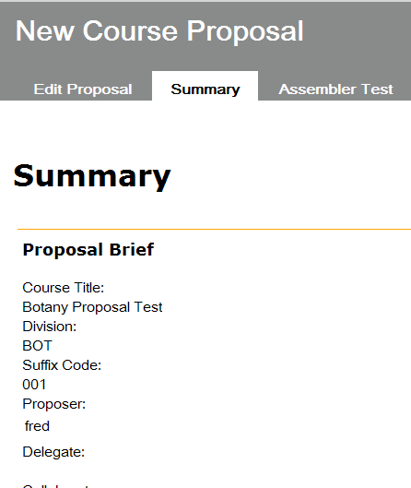
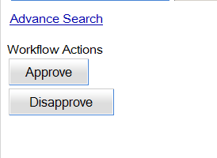
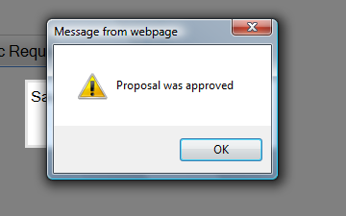
Proposal Review and Actions
Online support for workflow actions
Online support for reviewing proposal information
Proposer
Department
Faculty
Senate
Course Catalogue

Slide 21
Proposal Tracking
Fred reviews proposal periodically to see where proposal is in workflow cycle
Proposal status is updated automatically when collaborators or reviewers enter an action
Fred is able to see the action list at any time

Slide 22
Proposal Tracking - Fred
Action list displays all actions taken and pending
Proposer
Department
Faculty
Senate
Course Catalogue

Slide 23
Proposal Tracking - Fred
Proposal Approved!!
Proposer
Department
Faculty
Senate
Course Catalogue

Slide 24
What does KS-CDM Offer?
Learning Environment
Supports new types of learning experiences (project based, experiential) reducing need for workarounds
Leads to fewer courses listed but not offered – reduce frustrations
Organizations, People
Supports automated collaboration and approvals based on organization roles
Support the management and tracking of proposals from inception to approval
Intuitive user interface without double entry
Time
Allows flexible timeframes for courses
Opportunity to drastically reduce time required to approve courses

Slide 25
Kuali Student – CDM
Questions
Thank you

